Slide 1

CRUNCHY CORNER ANALYSIS

Slide 2
PURPOSE
Financial Performance Analysis: This project aims to assess and optimize key
financial metrics, including
Net Revenue, EBITDA, and Gross Profit, to drive profitability.
Data-Driven Decision-Making: By utilizing advanced DAX calculations, the
project provides insights that
support informed strategic decisions.
Cost Efficiency & Revenue Growth: The analysis helps identify opportunities for improving cost efficiency
and driving revenue growth within the organization.

Slide 3
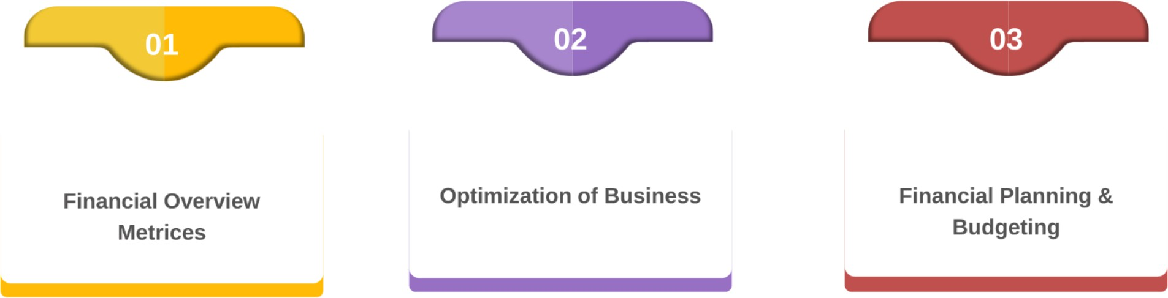
CLIENT REQUIREMENT

Slide 4
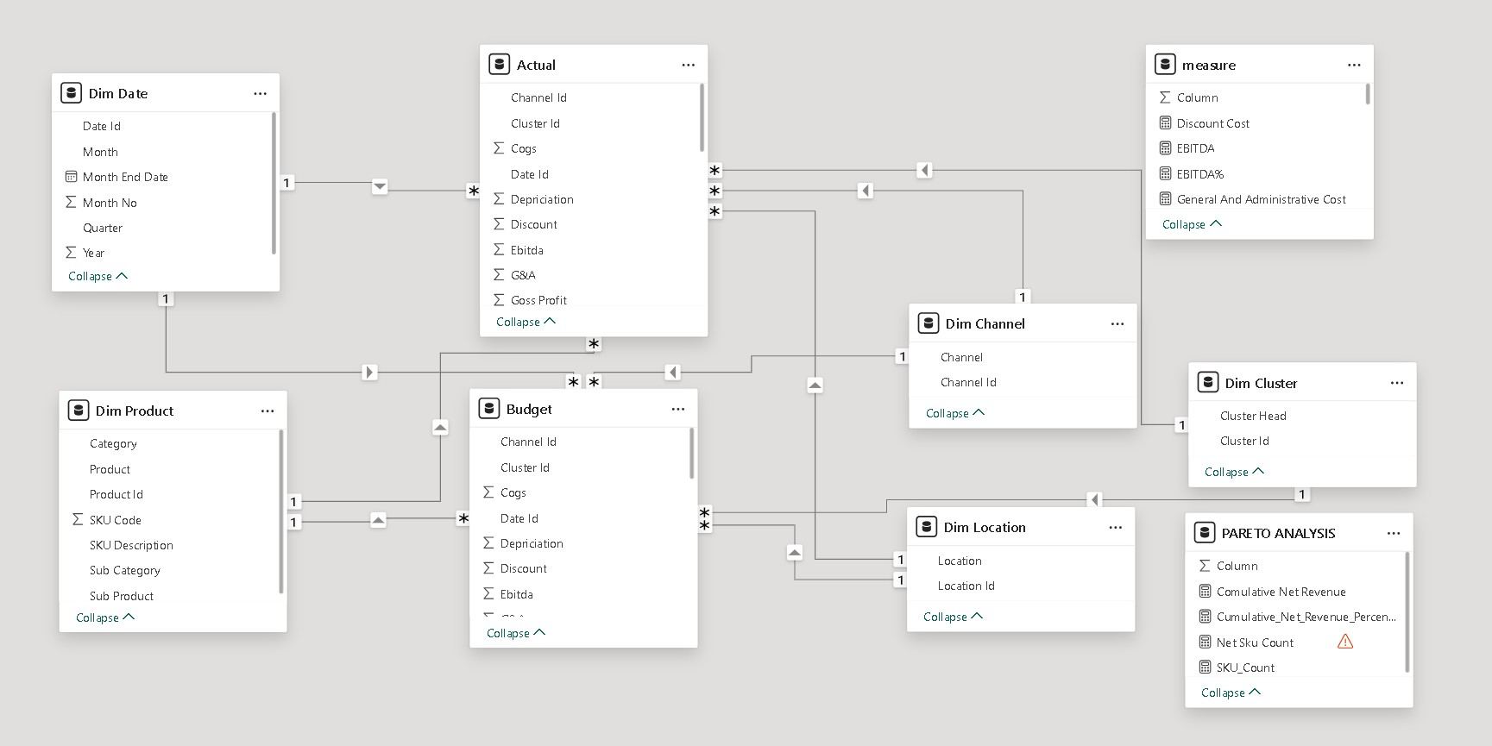
DATA MODEL

Slide 5
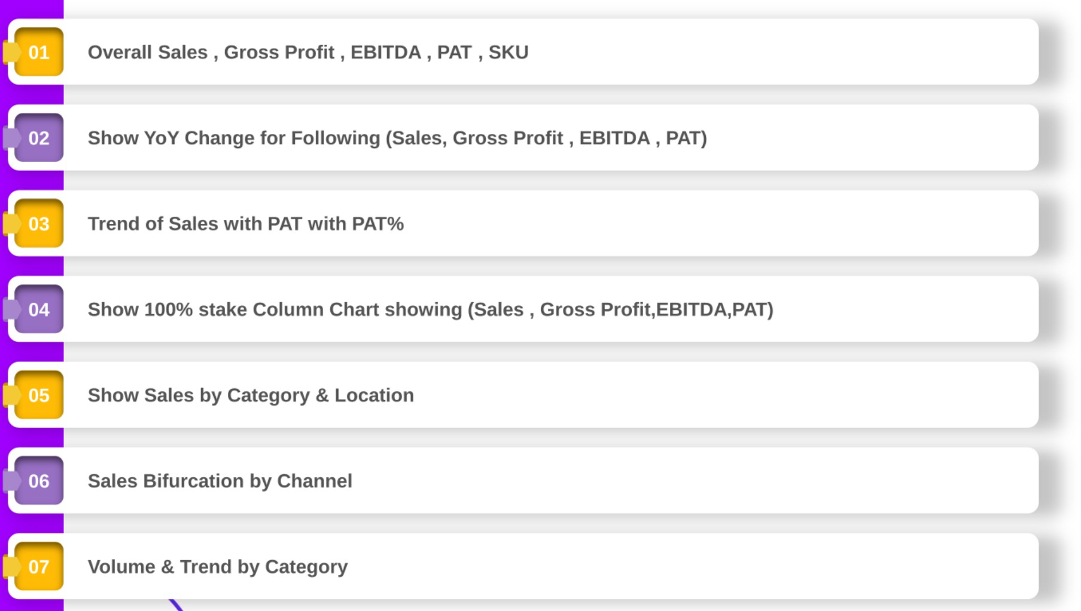
FINANCIAL PERFOMANCE REQUIREMENT

Slide 6
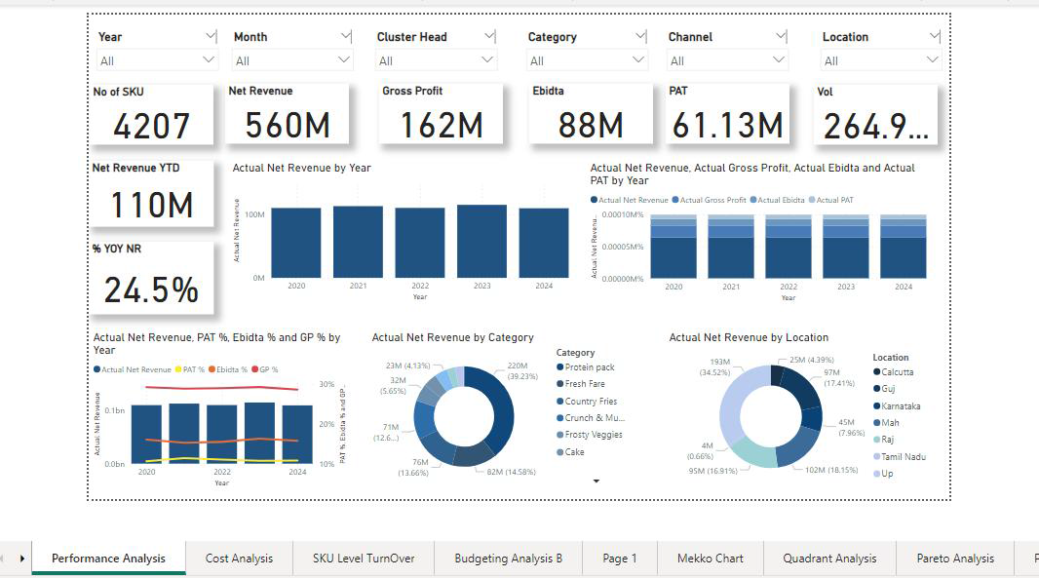
PERFOMANCE ANALYSIS

Slide 7
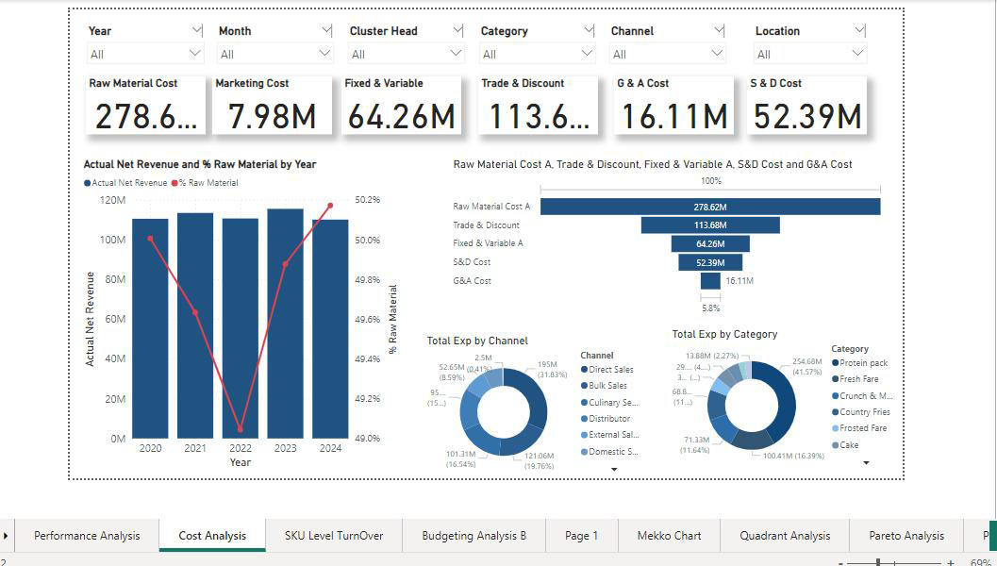
COST ANALYSIS

Slide 8
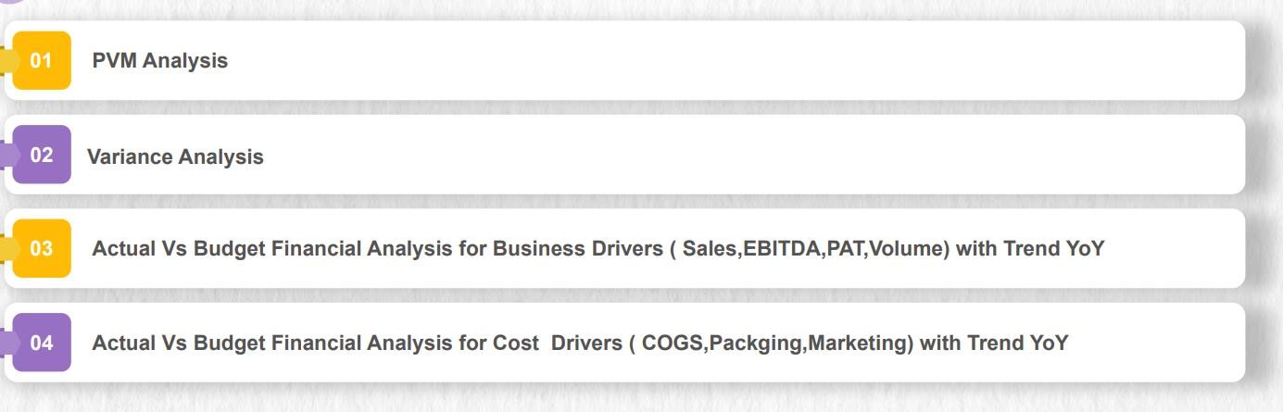
BUDGET ANALYSIS REQUIREMENT

Slide 9
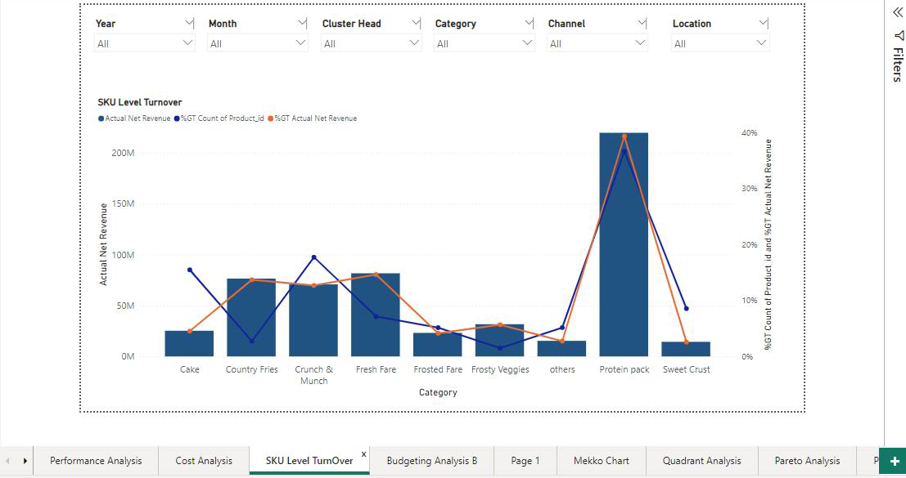
SKU level Turnover

Slide 10
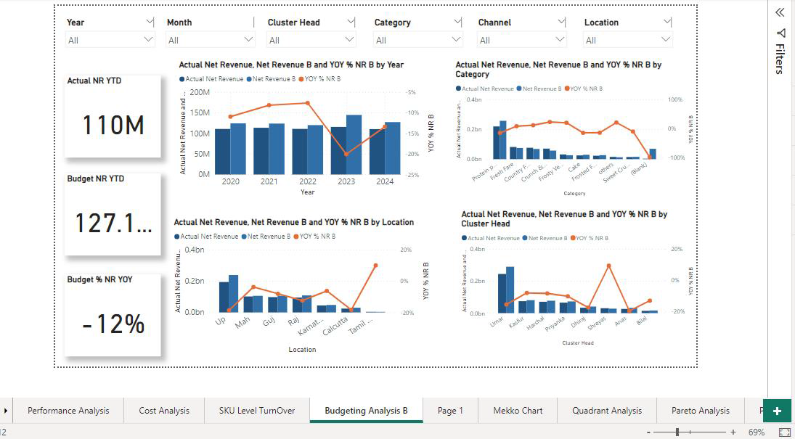
BASIC BUDGETING

Slide 11
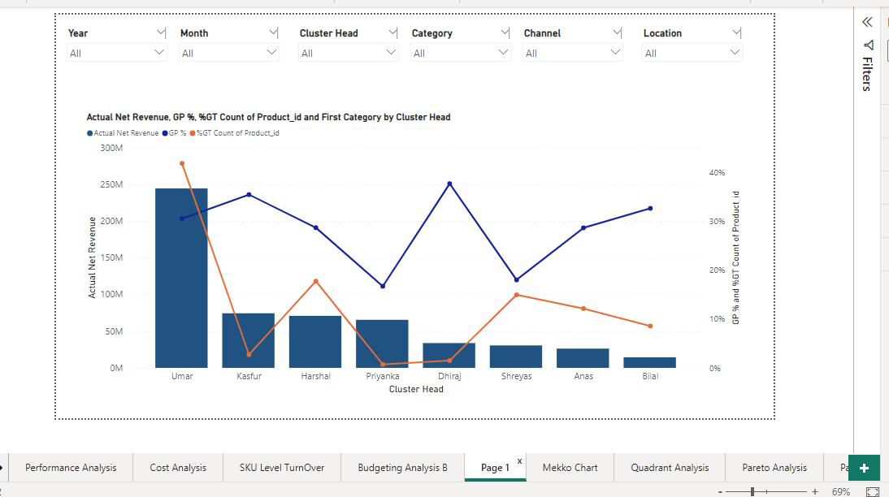

Slide 12
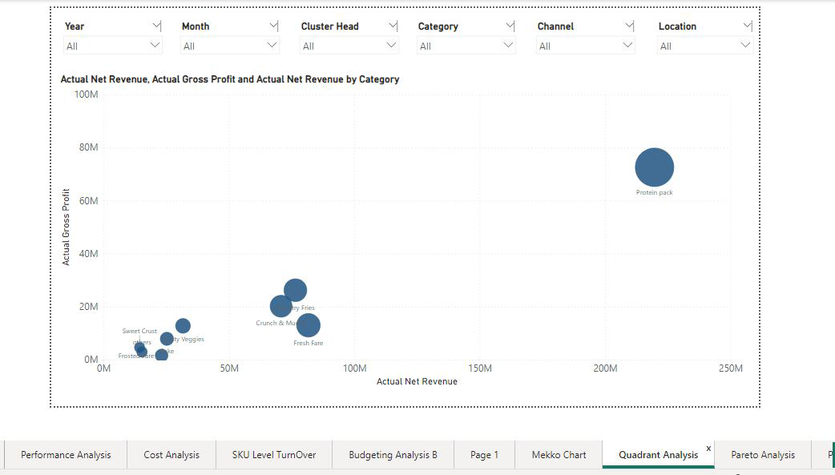
QUADRANT ANALYSIS

Slide 13
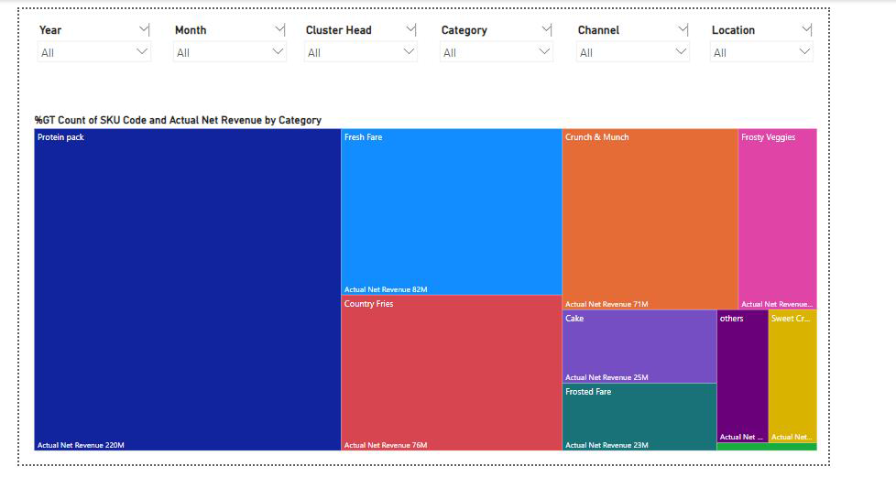
Tree Map Analysis

Slide 14
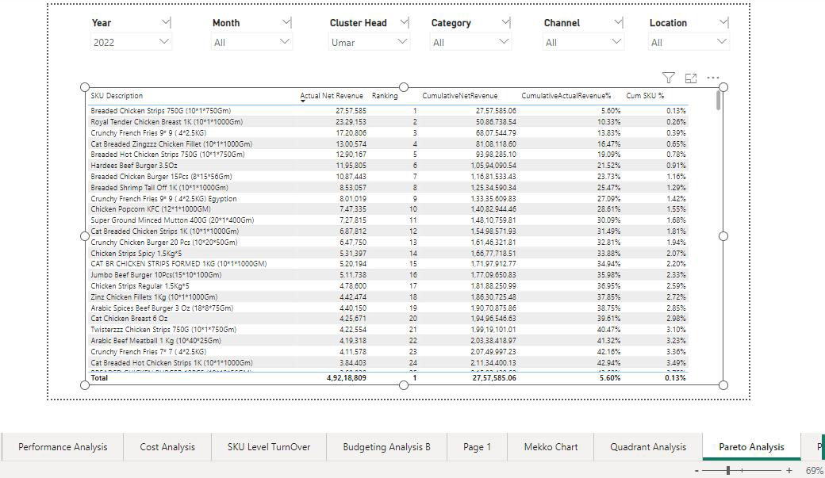
Pareto Analysis

Slide 15
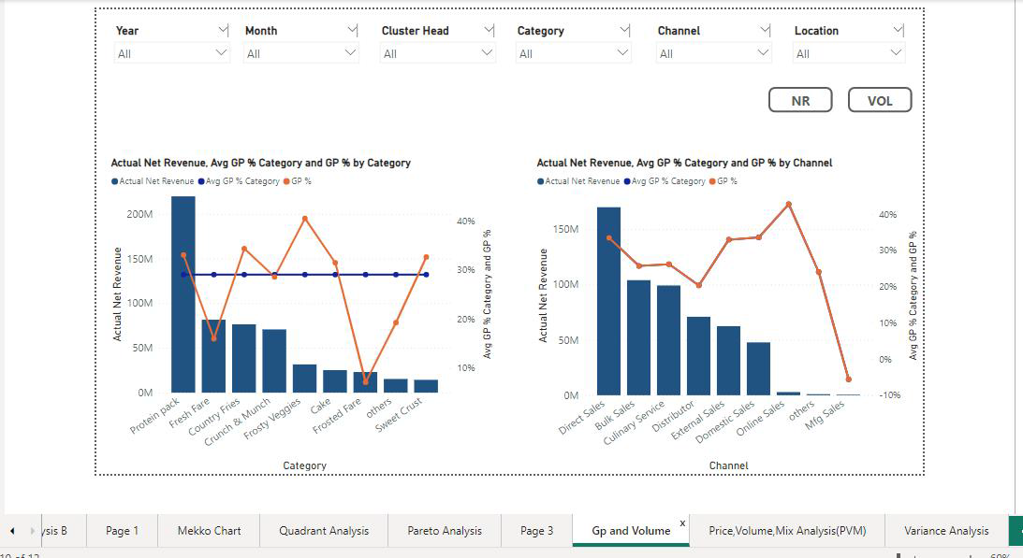

Slide 16
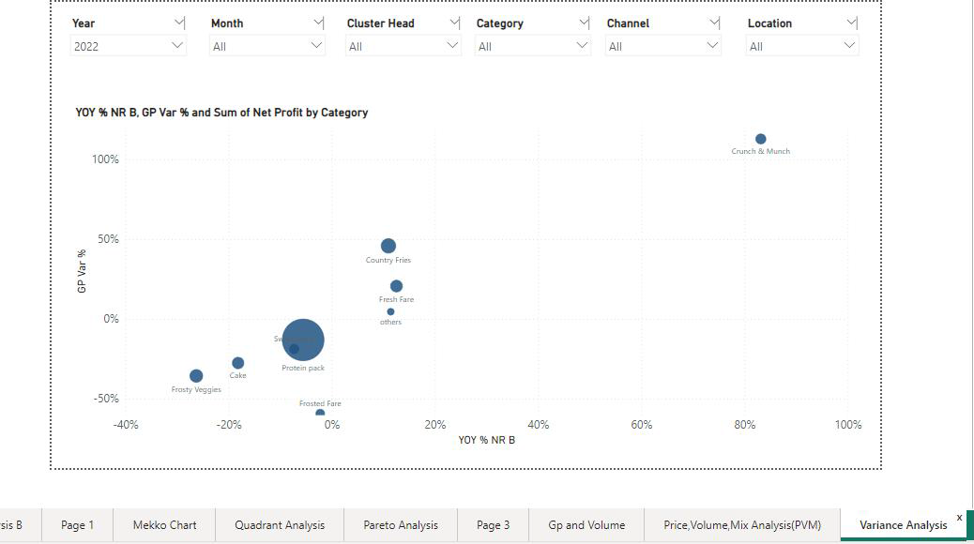
Variance Analysis

